Slide 1
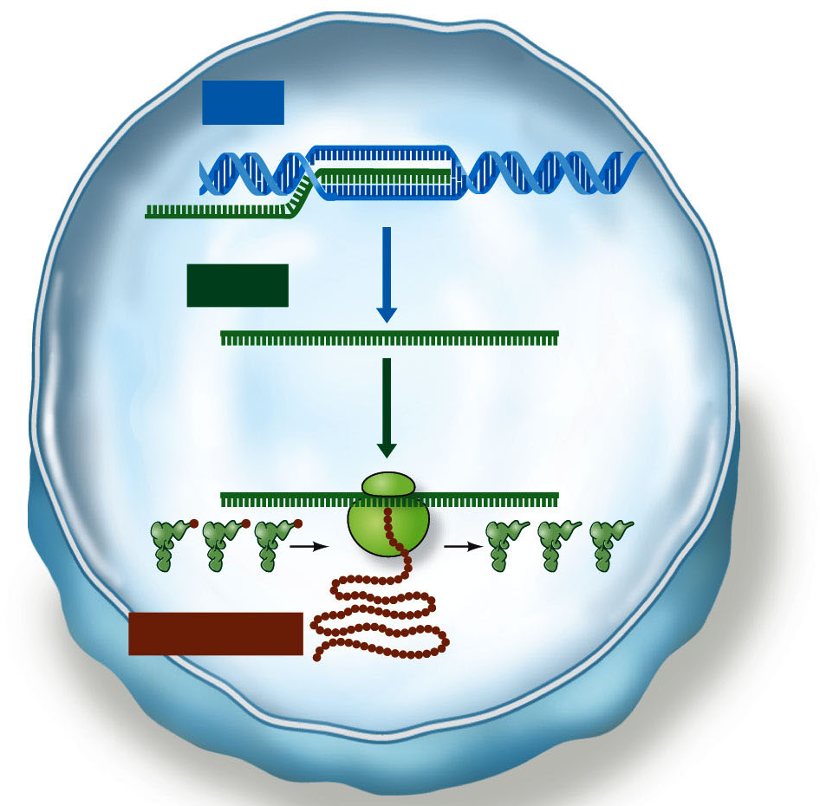
Intro to Biotech
Lect.6
DNA
mRNA
transcription
translation
Protein
tRNAs

Slide 2
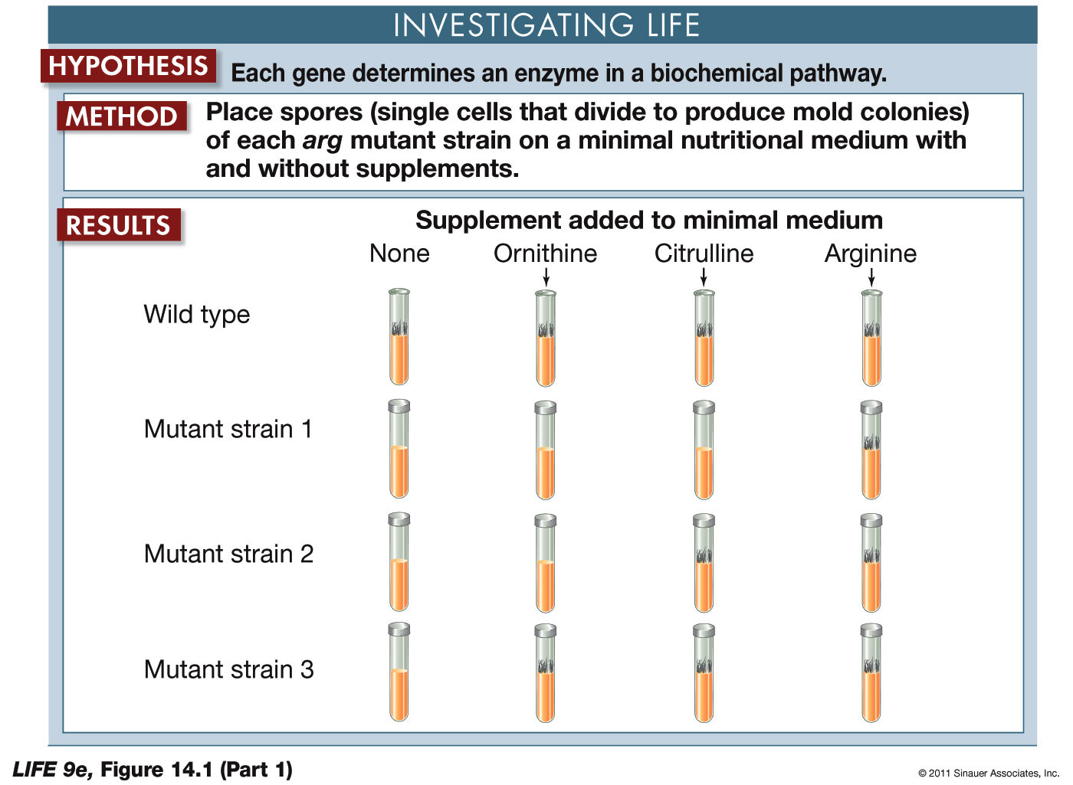
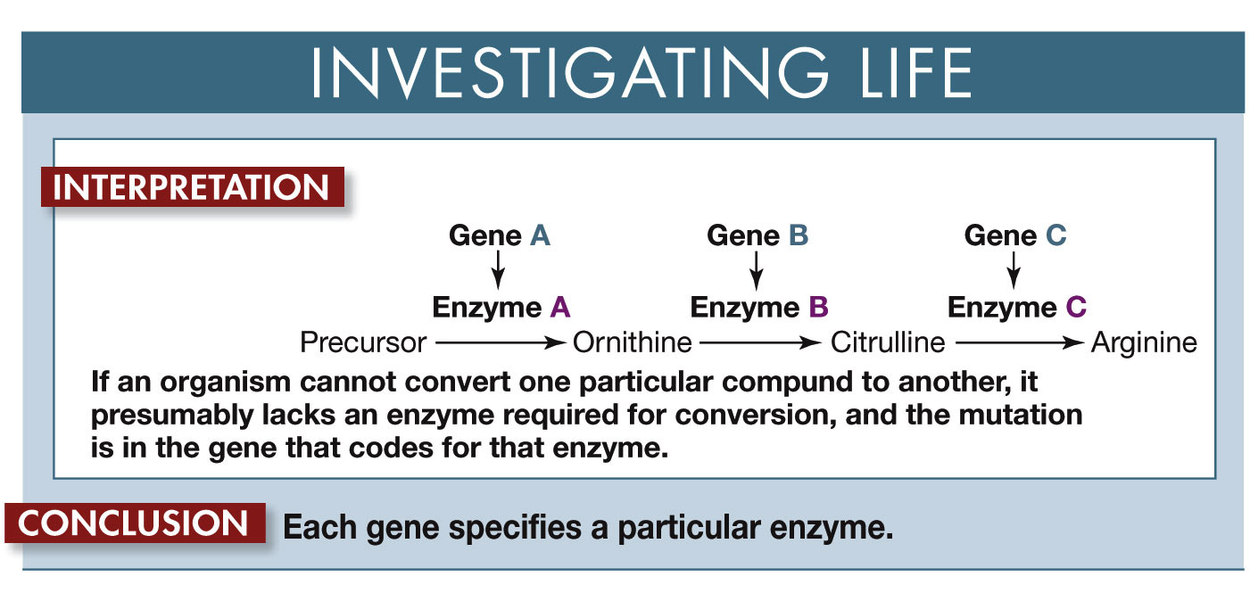
Intro to Biotech
Lect.6
Mutational Analysis
ONE GENE = ONE ENZYME

Slide 3
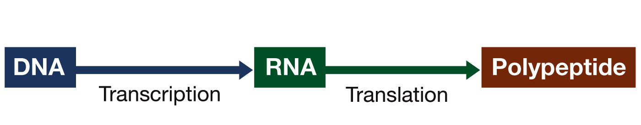
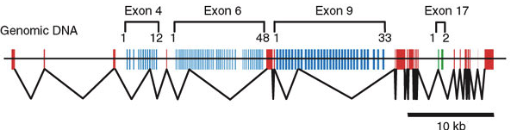
Intro to Biotech
Lect.6
DNA
mRNA
transcription
translation
ONE GENE
=
ONE ENZYME
Protein
tRNAs

Slide 4
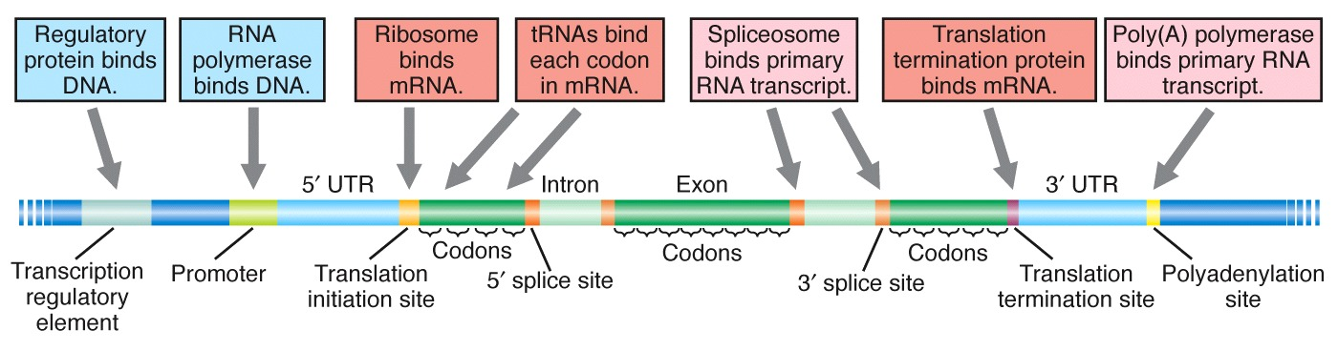
Intro to Biotech
Lect.6
Transcription – gene structure
• transcription unit • regulatory region
2.
3.
4.
1.
2.
3.
4.
prokaryotic
vs
eukaryotic
• regulatory sequences
• introns/exons
• operons
Problems?
1.
2.
3.

Slide 5
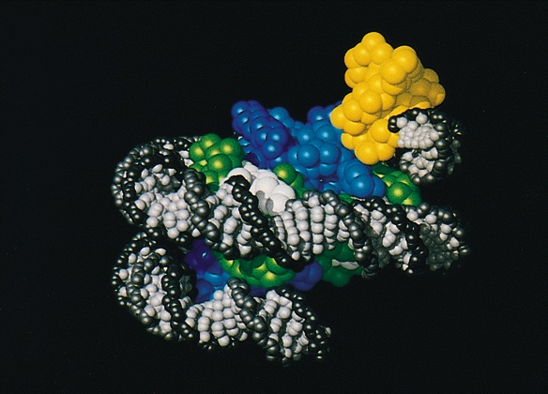
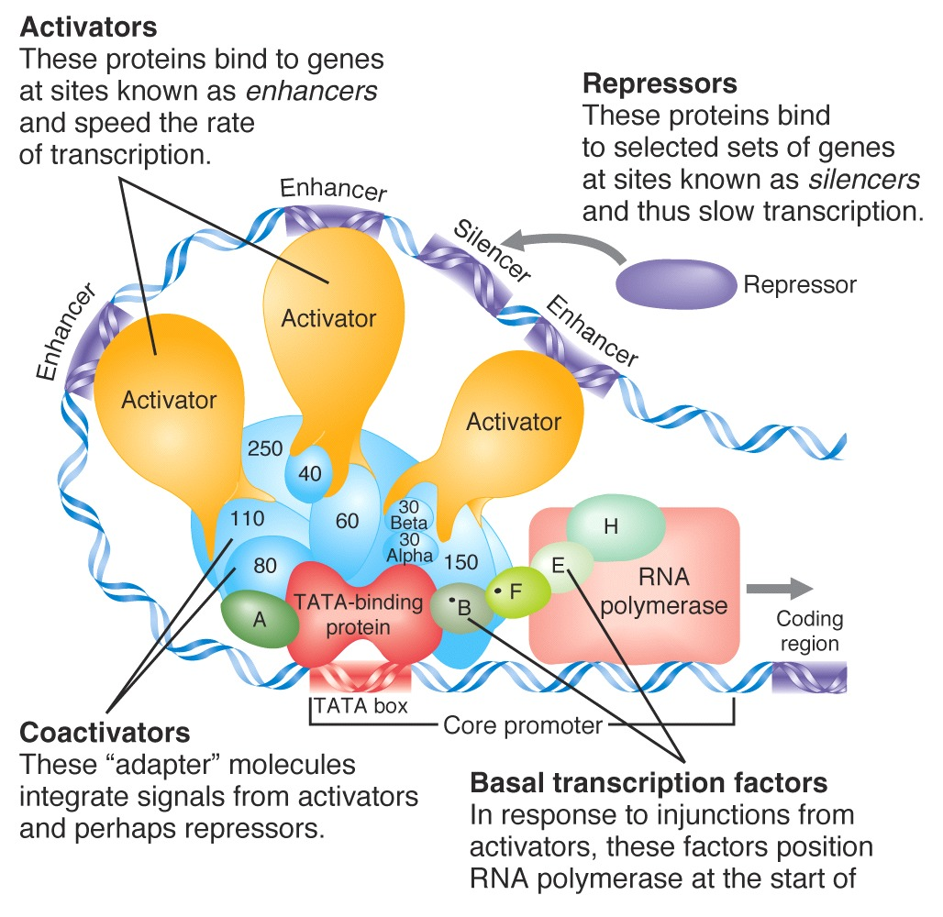
Intro to Biotech
Lect.6
How does Transcription occur?
- 4 phases
a.
b.
c.
d.
a. template recognition (access)
- local unpacking (nucleosome displacement)

Slide 6
Intro to Biotech
Lect.6
How does Transcription occur?
- 4 phases
a. template recognition (cis vs trans)
b. initiation
c. elongation
d. termination

Slide 7
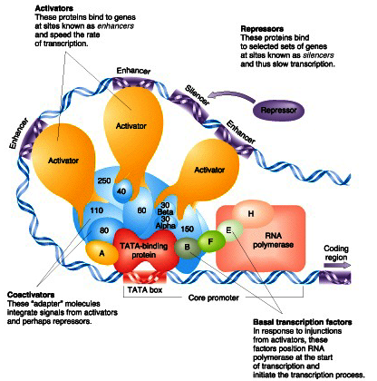
Intro to Biotech
Lect.6
a. template recognition (upstream!)
1. Cis elements
prokaryotic (E. coli)
5’
TTGacaT
TATaaT
3’
-35
-10
eukaryotic (PolII)
5’
ATATAA
3’
-30
- recognizes promoter region of coding strand
• =

Slide 8
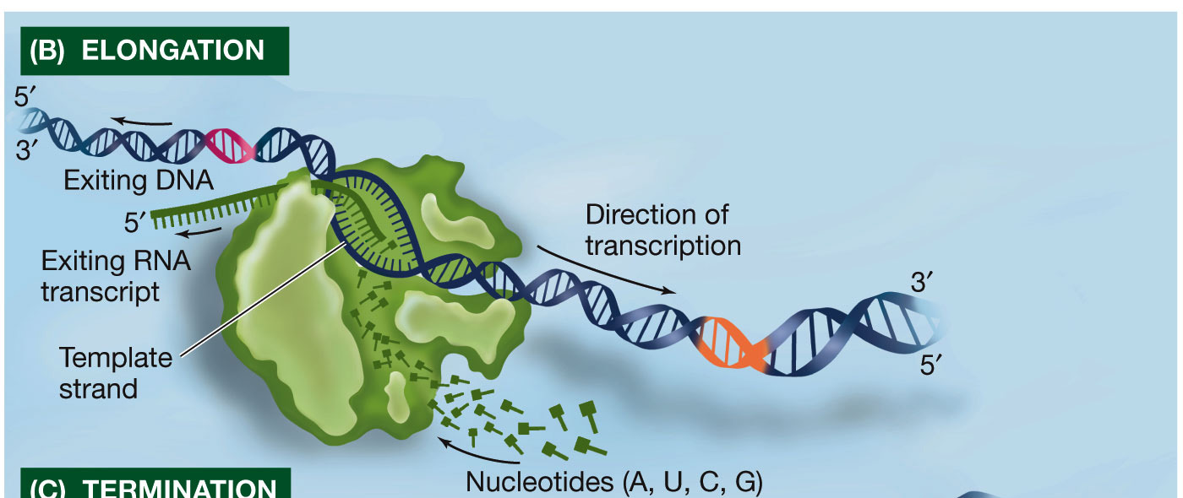
Intro to Biotech
Lect.6
How does Transcription occur?
b. initiation
- +1,
-
c. elongation
-
- transcription bubble
-
- coding strand vs template strand

Slide 9
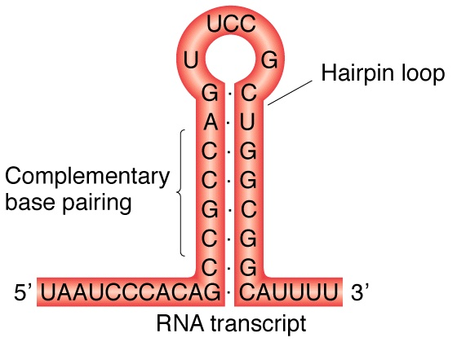
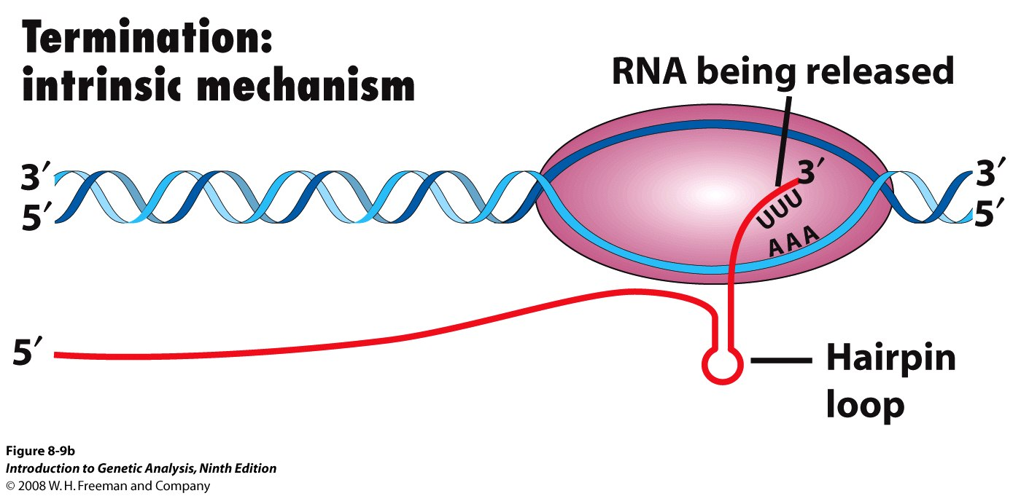
Intro to Biotech
Lect.6
How does Transcription occur?
d. termination: WHY??
- prokaryotic terminator
1.
2.
- eukaryotic ?

Slide 10
Intro to Biotech
Lect.6
DNA
12kb Primary transcript
5kb Mature transcript
• 1 intron
• avg exon size = ?
• ORF = 1000aa
• avg UTR size = ?

Slide 11
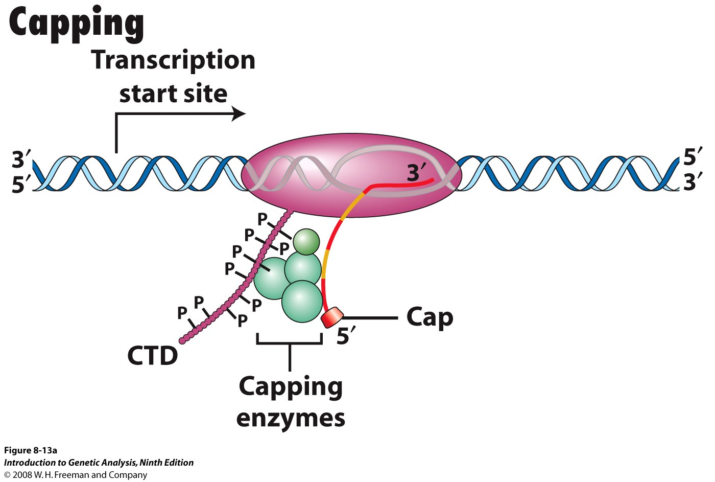
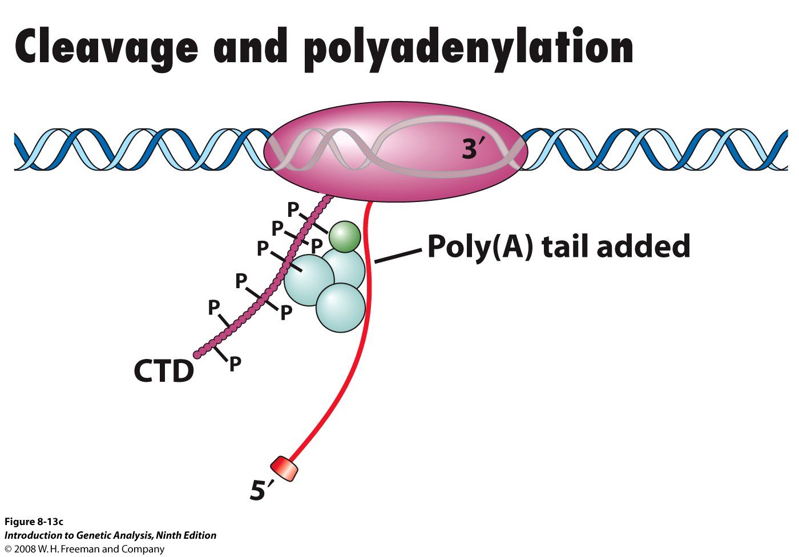
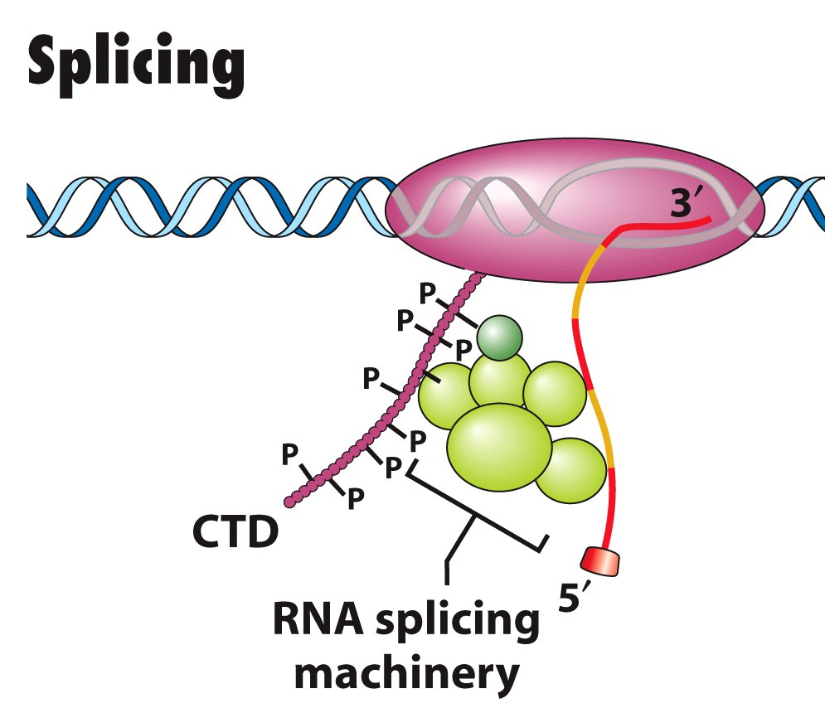
Intro to Biotech
Lect.6
Processing of mRNAs
Processing involves 4 steps:
Primary transcript
a. Capping
b. 3’ cleavage
c. polyadenylation
d. splicing
Mature (secondary) transcript translation
a. Capping (guanyltransferase)
-
b. Cleavage (endonuclease)
-
c. Polyadenylation (polyA polymerase)
-
d. Splicing (spliceosome)
-

Slide 12
Intro to Biotech
Lect.6
Transcription
prokaryotic
eukaryotic
location
Coding sequence
processing
Gene structure

Slide 13
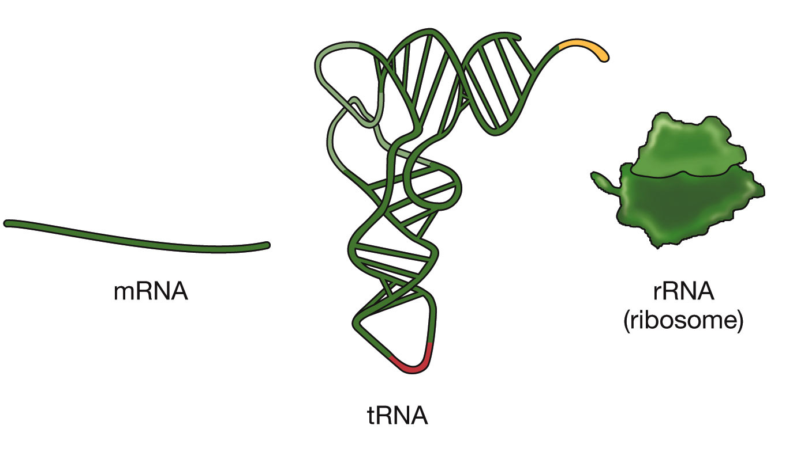
Intro to Biotech
Lect.6
RNA – where do we go from here?
Translation
- Discovery of genetic code
ncRNAs:
miRNA:
piRNA:
smallRNAs:
lncRNAs:

